Slide 1

Education and Research
We enable you to leverage knowledge anytime, anywhere!
C++ Part I
Day 4
ER/CORP/CRS/LA1010/003
Ver. No.: 4.0
Confidential
Copyright © 2008, Infosys Technologies Ltd.

Slide 2
General Guideline
© (2008) Infosys Technologies Ltd.
This document contains valuable confidential and proprietary information of Infosys. Such confidential and proprietary information includes, amongst others, proprietary intellectual property which can be legally protected and commercialized. Such information is furnished herein for training purposes only. Except with the express prior written permission of Infosys, this document and the information contained herein may not be published, disclosed, or used for any other purpose.

Slide 3
Confidential Information
This Document is confidential to Infosys Technologies Limited. This document contains information and data that Infosys considers confidential and proprietary (“Confidential Information”).
Confidential Information includes, but is not limited to, the following:
  Corporate and Infrastructure information about Infosys
  Infosys’ project management and quality processes
  Project experiences provided included as illustrative case studies
Any disclosure of Confidential Information to, or use of it by a third party, will be damaging to Infosys.
Ownership of all Infosys Confidential Information, no matter in what media it resides, remains with Infosys.
Confidential information in this document shall not be disclosed, duplicated or used – in whole or in part – for any purpose other than reading without specific written permission of an authorized representative of Infosys.
This document also contains third party confidential and proprietary information. Such third party information has been included by Infosys after receiving due written permissions and authorizations from the party/ies. Such third party confidential and proprietary information shall not be disclosed, duplicated or used – in whole or in part – for any purpose other than reading without specific written permission of an authorized representative of Infosys.

Slide 4
Session Plan Day 4
Dynamic Memory Allocation Using malloc()
Dynamic Memory Allocation Using calloc()
Dynamic Memory Allocation Using realloc()
Dynamic Memory Allocation – new & delete operators.
Difference between malloc() and new.
Dynamic Memory Allocation
Memory Leak and debugging.
Concept of Law of Big 3.
Has-a relationship
Uses relationship

Slide 5
Dynamic Memory Allocation Using malloc()
Syntax
void *malloc (size_t);
malloc() allocates memory dynamically for an object with the specified size on heap.
malloc() expects size of the object as a parameter.
The returned pointer needs to be typecast to point to specific object type.
On success it returns first byte address of the memory block.
On failure it returns NULL.
The memory block returned by malloc() will not be cleared (may contain some junk data).
When Memory is allocated for objects using malloc() its constructor will not be invoked.
Only allocates memory, returns the starting address. constructor is not called
Employee *poE = (Employee *) malloc (sizeof (Employee) );
Notes:
Syntax:
void *malloc(size_t size);
Dynamic allocation is a way to allocate the memory at run time using C/C++ standard allocation .
In C ‘malloc’ and ‘calloc’ function were used to do this task.
Both these functions does contiguous block of memory allocation , malloc() function takes size as the argument.
A pointer to the allocated memory is returned by malloc() after allocating size bytes.
The memory retuned by malloc() ma have some garbage value.
Example:
Syntax:
void *calloc(size_t arraysize, size_t element_size);
calloc() reserves memory to array of arraysize elements of ‘element_size’ bytes each and a pointer is returned to the allocated memory.
Note: Memory allocated in calloc will be zero initialized memory block.
Example:
#include<iostream>
using namespace std;
class Emp {
private:
int empId;
char empName[30];
public:
void setData(){
cout<<"enter empId and empname\n";
cin>>empId>>empName;
}
void getData() {
cout<<empId<<" "<<empName<<endl;
}
};
int main(int argc,char** argv) {
/* variable to denote the size of array */
int iArrInd = 5;
int i;
/* pointer to our array */
Emp *pEmpArr;
// Allocate memory using calloc
pEmpArr = (Emp *) malloc(iArrInd*sizeof(Emp));
/* loop over the array, and get the data from user using set method*/
for(i=0; i<iArrInd; i++) {
pEmpArr [i].setData();
}
/* use the array of objects */
for(i=0; i<iArrInd; i++) {
acEmpArray [i].getData();
}
/*memory is freed and the program ends*/
free(pEmpArr);
return 0;
}

Slide 6
Dynamic Memory Allocation Using calloc()
Syntax:
void *calloc(size_t nmemb, size_t size);
Returns a contiguous space in memory that is nmemb*size big.
The returned memory is set to zero.
Typecasting to specific type is required after the allocation.
Useful in creating an array of ‘n’ elements of size ‘size’ each.
calloc() may be bit slower than malloc().
Notes:
Syntax:
void *calloc(size_t arraysize, size_t element_size);
calloc() reserves memory to array of arraysize elements of ‘element_size’ bytes each and a pointer is returned to the allocated memory.
Note: Memory allocated in calloc will be zero initialized memory block.
Example:
#include<iostream>
using namespace std;
class Emp {
private:
int empId;
char empName[30];
public:
void setData(){
cout<<"enter empId and empname\n";
cin>>empId>>empName;
}
void getData() {
cout<<empId<<" "<<empName<<endl;
}
};
int main(int argc,char** argv) {
/* variable to denote the size of array */
int iArrInd = 5;
int i;
/* pointer to our array */
Emp *pEmpArr;
// Allocate memory using calloc
pEmpArr = (Emp *) calloc(iArrInd,sizeof(Emp));
/* loop over the array, and get the data from user using set method*/
for(i=0; i<iArrInd; i++) {
pEmpArr [i].setData();
}
/* use the array of objects */
for(i=0; i<iArrInd; i++) {
acEmpArray [i].getData();
}
/*memory is freed and the program ends*/
free(pEmpArr);
return 0;
}

Slide 7
Dynamic Memory Allocation Using realloc()
Syntax;
void *realloc(void *ptrA, size_t size);
realloc() is used to change the size of the memory block previously allocated for ‘ptrA’ to ‘size’ bytes.
There will be no change in the contents till the minimum of the old and the new size.
realloc() returns uninitialized memory.
If ptrA is NULL, then the call is equivalent to malloc(size).
if size is equal to zero, the call is equivalent to free(ptr).
Notes:
Syntax:
void * realloc(void * ptrA, size_t mem_size);
If available contiguous memory blocks are not sufficient then the new memory block is allocated.
The data present the previous bock is copied and the original memory block is freed.
The realloc() function changes the size of an allocated memory block. The ptrA argument points to the beginning of the new memory block.
If the pointer is NULL then it behaves in the similar to malloc(size).
Example:
#include <iostream>
using namespace std;
int main (int argc,char **argv){
/*iData to store the data from user,iLoop,iCount used a loop count*/
int iData,iLoop;
int iCount=0;
//integer pointer to store the data from user
int *iPtr = NULL;
do{
//get data from user and break from loop if it 0
cout<<"Enter an integer value (0 to end): ";
cin>>iData;
if(iData==0){
break;
}
iCount++;
/*calling realloc function to reallocate the memory to the pointer
breaking the loop if allocation fails*/
iPtr = (int*) realloc (iPtr, iCount * sizeof(int));
if (iPtr==NULL){
cout<<"Reallocation failed at "<<iCount<<" element";
break;
}
//store the data in the array
iPtr[iCount-1]=iData;
}while(1);
//printing the data on screen
cout<<"Numbers entered: "<<endl;
for (iLoop=0;iLoop<iCount;iLoop++){
cout<<iPtr[iLoop]<<endl;
}
free (iPtr);
return 0;
}

Slide 8
Releasing memory : free()
Syntax:
void free (void *Ptr1);
releases the memory block which has been held by Ptr1.
No operation takesplace incase Ptr1is NULL
      float *fPtr;
      fPtr=(float*)malloc(10 * sizeof(float);
      ………
      ………
      free (fPtr);
Notes:
free() is used to de allocate the memory space allocated to Ptr1, by any of the memory allocation functions (calloc(),malloc(),realloc() )
calling free twice on the same pointer can lead to unpredictable behavior or run time crashes.
Example:
#include <iostream>
int main (int argc,char **argv){
//declaring float and int pointers
float * fPtr;
int * iPtr,* iPtr1;
//allocate memory to iPtr,fPtr using malloc and calloc
iPtr = (int*) malloc (100*sizeof(int));
fPtr = (float*) calloc (100,sizeof(float));
//reallocing memory of iPtr using realloc
iPtr1 = (int*) realloc (iPtr,500*sizeof(char));
//free memory
free (fPtr);
free (iPtr1);
return 0;
}
Note: try to free the pointer twice and check what happens.

Slide 9
Dynamic Memory Allocation – new & delete operators
C++ uses new and delete operators to allocate and de allocate memory respectively at run time.
The new operator is used for allocating the memory and returns a pointer to the start of allocated memory.
The delete operator releases memory which was reserved using with the help of new.
Syntax of new and delete : p_var1 = new type;
delete p_var1;
Here, p_var1 is a pointer variable that receives a pointer to memory that is large enough to hold an item of type type.
Trainee *poT = new Trainee(1001, “Jumpy”);
Apart from allocating memory, it also calls the constructor
Notes:
Just as we have malloc and free for dynamic memory allocation in case of C, we have new and delete in C++.
These are actually objects which can be used for dynamic memory allocation. Always remember to delete the memory allocated once the job is done.
Even though malloc/free allocates and releases the memory respectively, Constructor is not called during dynamic object creation.
Hence we should use new for dynamic memory allocation for objects.

Slide 10
Dynamic Memory Allocation – Example (using new & delete)
#include <iostream>
#include <string>
using namespace std;
int main() {
// Allocating memory for one integer
int *pIntO= new int;
*pIntO=100;
cout << *pIntO << endl;
delete pIntO;
/* Allocating memory for one integer and initializing it to 500 */
int *pIntTo= new int(500);
cout << *pIntTo << endl;
delete pIntTo;
// Allocating memory for 6 characters
char *pChar= new char[6];
strcpy(pChar,"Jumpy");
cout << pChar << endl;
delete []pChar;
// Deallocating pChar
return 0;
}
Notes:
Extra Information:
In C++, new is an operator which is having some specific functionality. It is declared in global namespace not in std namespace.
new is having different format/versions.
General syntax:
1. void * new(size)
2. void * new[](size) //this is used in case of arrays. Called as array forms
It throws an exception when failed. Handling exceptions will be dealt in Cpp-part2.

Slide 11
Dynamic Memory Allocation – Example (using new & delete)
#include <iostream>
#include <string>
using namespace std;
class Trainee {
char *charNm;
public:
Trainee(char charStr[]);
~Trainee();
void Details() {
cout << charNm ;
}
};
Trainee::Trainee( char charStr[]) {
charNm= new char[strlen(charStr)+1];
strcpy(charNm,charStr);
}
Trainee :: ~Trainee() {
if(charNm !=NULL)
delete []charNm;
}
int main() {
Trainee *poT = new Trainee("Jumpy");
poT->Details();
delete poT;
return 0;
}
Notes:
De-allocating memory using delete:
Delete ptr : will de allocate memory at only one location. i.e ptr
Delete []ptr: will de allocate memory allocated for the ptr array.
( you have mention [] in case of arrays)
Similar to new, even delete has many formats/versions

Slide 12
Difference between malloc() and new
malloc() | new
'malloc()' allocates a sequence of bytes and it will not invoke constructor. | 'new' does the allocation as well as has the responsibility of invoking the constructor.
In case of ‘malloc()’ memory returned by it needs to be typecast to point it to specific type of object | ‘new’ does not require this explicit typecasting.
On failure 'malloc' returns 'NULL' | On failure new operator throws exception know as 'std::bad_alloc’
Notes:
'malloc' is the C way of dealing with the free store while 'new' is the C++ way.
'malloc()' allocates a sequence of bytes while 'new' does the allocation as well as has the responsibility of invoking the constructor.
In case of ‘malloc()’ memory returned by it needs to be typecast to point it to specific type of object where as ‘new’ does not require this.
On failure 'malloc' returns 'NULL' where as 'new' throws an exception object of type 'std::bad_alloc'.

Slide 13
Difference between malloc() and new
malloc() | new
There are no array forms of malloc() and free(). | 'new' and 'delete' have array forms.
'free()' on 'NULL' pointers is not safe | ‘delete’ on NULL pointers is safe.
'free()' deallocates all bytes allocated by a prior 'malloc()' call | 'delete' makes a call to the destructor and then goes on with the deallocation.
Notes:
Every call to 'malloc()' should be followed by a call to 'free()' while every call to 'new' should be followed by a call to 'delete'.
'free()' deallocates all bytes allocated by a prior 'malloc()' call (using the same pointer) while 'delete' makes a call to the destructor and then goes on with the deallocation.
There are no array forms of malloc() and free() while 'new' and 'delete' do have.
'free()' on 'NULL' pointers is not safe while 'delete' is.

Slide 14
Dynamic Memory Allocation
The dynamic memory allocation happens on the heap.
Heap is a memory space which grows or shrinks dynamically.
Whenever the memory is allocated dynamically for any object, a space is allocated in the heap. This allocation remains until it is deleted (freed).
If a program fails to de-allocate memory, that memory cannot be used by other programs. This is called as “memory leak”.
int main() {
Trainee *poT = new Trainee("Jumpy");
poT->Details();
// delete poT;
return 0;
}
Notes:
In C++, space in memory for variables may be either statically or dynamically allocated.
Dynamic allocation of memory is done using new and delete or malloc and free as discussed.
In case of static memory allocation for the local variables, the allocation happens on the stack. The global variables on the other hand are allocated memory on the Global Address space (Data segment).
The static allocation is done at compile time and the allocated memory is predetermined and leads to wastage or wrong calculation of space.
In case of statically allocated memory the stack memory is released when the programs life ends.
On the other hand, the dynamic memory allocation on heap memory has to be managed by the programmer explicitly.

Slide 15
Memory Leak
When the memory is allocated dynamically it becomes the user responsibility to de allocate it once the work is done or specially before the pointers to the object go out of scope.
Golden Rule: Every new must have an associated delete. (This is true even in case of the malloc / free).
Failure to do so results in a memory leak.
int main() {
int *pInt = new int[50];
char *pChar = new char[100];
{
char *Name = new char[25];
// Use Name
}
/* Memory Leak: Name not
deleted before it goes out
of scope */
delete pChar;// Memory Leak!
delete []pInt; // OK
return 0;
}
Notes:
Memory leaks when present in the a long running program can deteriorate the performance the computer very badly .
It is Programmers responsibility to release the memory before it goes out of scope.
For your information:
we have garbage collectors in java which will take care of this memory leaks.

Slide 16
Detection of Memory Leak
valgrind supports number of tools which can detect many memory related errors e.g., Memcheck tool, which is used for checking memory related issues :
  Restricting the access to unauthorized memory(eg. Exceeding heap block boundaries, or accessing freed memory).
  Memory leak.
  Using uninitialized values.
  Memory freeing issues , such as double-freeing heap blocks.

Slide 17
Memory leak example
#include<iostream>
using namespace std;
int main(int argc,char **argv) {
/*dimention for toy integer array */
int ArrayLength = 10,i;
/* pointer to our array */
int* ArrayPtr;
/* declaring memory dynamically to integer array */
ArrayPtr= new int[ArrayLength];
/* traversing the arary, and performing some colculations */
For( i=0;i<ArrayLength;i++) {
ArrayPtr[i] = i*10;
}
ArrayPtr=new int[ArrayLength];
/* traversing the arary, and performing some colculations */
for( i=0;i<ArrayLength;i++) {
ArrayPtr[i] = i*20;
}
/* freeing memeory allocated using malloc() and end program */
delete ArrayPtr;
return 0;
}
Memory allocation 2
Memory allocation 1
Memory release 1
Notes:
In this program first we have allocated block of memory for intArray and then we have used it. Once again we are trying to allocate another block of memory for intArray, without releasing the earlier block of memory. This causes memory leak.

Slide 18
Steps to use Valgrind
Compile the program with –g option .
Use valgrind tool with –leak-check option set to yes.
$g++ –g –o final MyProg.cpp
valgrind --leak-check=yes ./final
Notes:
If you compile the program using option -g, the object program will include debugging information. This y the makes the valgrind tool to identify and notify appropriate lines in the source code containing memory related issues.
Running your program under Memcheck
If you normally run your program like this:
ProgramName argument1 argument2
Use the following command :
valgrind --leak-check=yes ProgramName argument1 argument2
the default tool is Memcheck.
The option --leak-check enables the complete memory leak identification.
Enabling Memcheck can result in slowing down the performance of your code by 20-30 times as it will give you error messages where ever there is a memory leak.

Slide 19
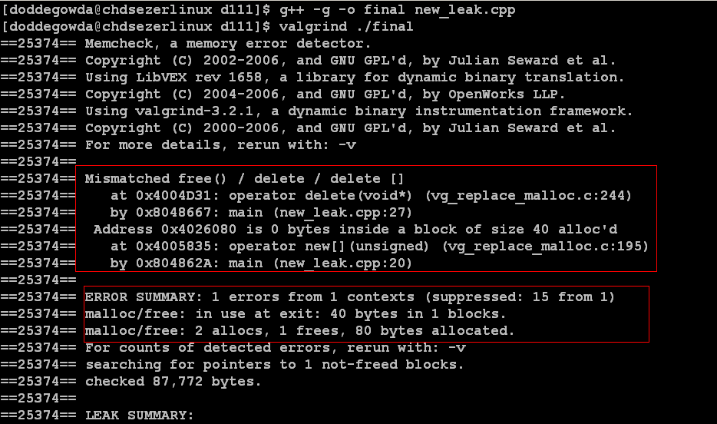
Demo
Mismatch in using delete along with line number
Showing mismatch in number of calls to new and delete and also show the number of bytes in use after the program exit

Slide 20
Best Practices in using new and delete operators
With respect to objects we use new and delete operators to reserve and release memory respectively.
Dynamic Memory allocation/de-allocation for primitive data types can be done through malloc, realloc and free.
All the memory allocations that happen within the class needs to be deallocated within the destructor.
All the object pointers allocated dynamic memory must be deleted when not required.

Slide 21
Violation of golden rules
What is the problem with the code given below ?
int *ptr= new int[20];
*ptr= new int[50];
Answer
It allocates a block of 20 integers and ptr is pointing to it and without freeing that ptr is made to point to another block of 50 integers. So first allocated block becomes GARBAGE.
Rule violated
Never allocate Twice without freeing the memory already allocated
Remedy
Before allocating the second block free the space occupied by first block
int *ptr= new int[20];
delete []ptr;
*ptr= new int[50];

Slide 22
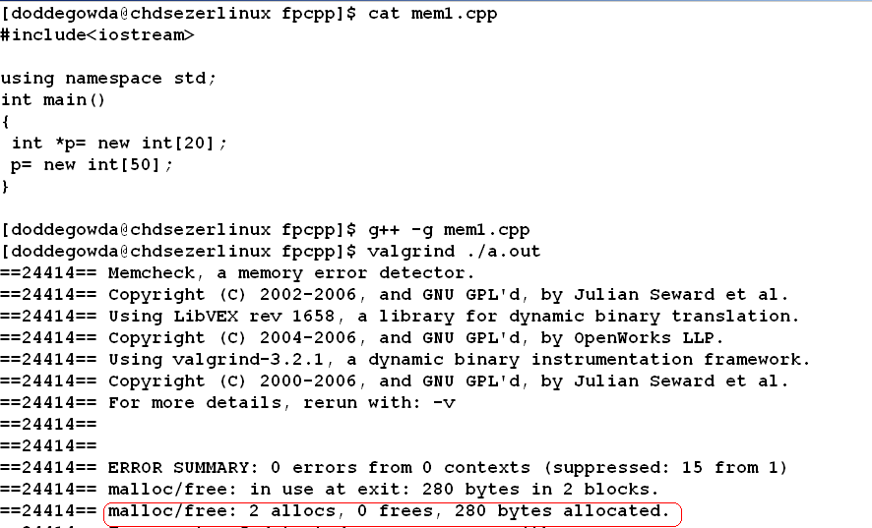
Demo
Notes:
In this demo we have

Slide 23
Violation of golden rules…
What is the problem with the code given below ?
int *p;
*p=20;
Answer
p is not initialized so it contains a garbage value so assignment to the location pointed by p will make system crash
Violated Rule
Never use uninitialized pointers

Slide 24
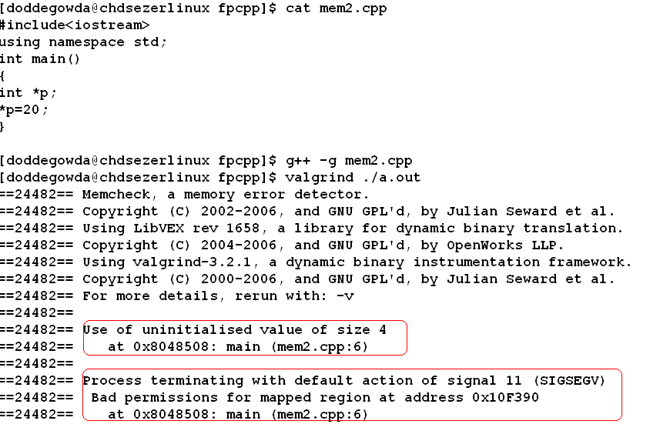
Demo

Slide 25
Violation of golden rules…
What is the error in the code given below?
int *ptrI =new int[10];
….
….
delete [] ptrI;
…
…
delete [] ptrI;
Answer
Trying to deallocate twice
Violated rule
Never deallocate twice

Slide 26
Violation of golden rules…
What is the error in the code given below?
int *p=new int[30];
……
delete []p;
…..
p[8]=125;
Answer
Trying to use a memory region that is deallocated
Violated rule
Never use deallocated memory

Slide 27
Violation of golden rules…
What is the problem in the code given below ?
int *p = new int[100];
p=NULL;
Answer
The code allocates a block of 100 integers and without freeing that makes p to NULL that means the block of 100 integers becomes a garbage
Violated Rule
Free memory after usage and don’t create garbage
Remedy
int *p = new int[100];
delete []p;
p=NULL;

Slide 28
Violation of golden rules…
What is the error in the code given below?
char *charStr=“hello world”;
….
delete charStr;
Answer
Trying to free memory allocated by compiler
Violated Rule
Never try to deallocate memory allocated by compiler

Slide 29
Concept of Big THREE
c++ has three important functions
  Copy Assignment Operator
  Destructor
  Copy constructor
These three are collectively called as “Big Three”.
Compiler generates all the above three functions by default.
The rule says that “If a class defines one of the above functions, then it should probably define all the three explicitly”.
This fancy name was given by Marshall Cline et al in C++ FAQs.
Notes:
The Copy Assignment operator , Copy constructor and destructor are collectively called as “The Big Three”.
A simple rule of thumb is that if you define a destructor , then you should always provide copy constructor and assignment operator, and also ensure that these are working in co- ordination with each other.
You must implement all the three for any class that manages heap memory.
“Big three” comes in to the picture only when class memory allocation is using the heap memory, if STL are used slike vector, sets etc., then “Big three” is already implemented while the implementation of STL.

Slide 30
Copy constructor
It is special type of constructor which gets invoked when we are trying to create a new object using another object.
Copy constructor is invoked:
  A declaration along with initialization as shown below:
    Employee oEmp2 = oEmp1;
    Employee oEmp1(oEmp2);
  Object is passed as argument to function as call-by-value (not as by reference or const reference).
  When the object is returned from the function as by value( not as reference).
Notes:
‘Copy constructor’ is a special constructor required to construct a new object that is initialized to a copy of the same type of object.
Copy constructor is invoked:
A declaration along with initialization as shown below:
Employee oEmp2 = oEmp1;
Employee oEmp1(oEmp2);
Object is passed as argument to function as call-by-value (not as by reference or const reference).
When the object is returned from the function as by value( not as reference).
As shown, first case is easy to understand as the objects constructed are requested explicitly.
While pass by value or return by value temporary copy of objects are created, which are not visible to user.

Slide 31
copy constructor ....
Copy constructor is implemented by applying copy constructors to each data member in object turn.
For Primitive data types , it performs simple assignment .
For user define objects, the copy constructor for every member data is also applied to that member data.

Slide 32
copy assignment operator, =
Assignment ‘=‘ operator is applied to two existing objects.
if “=“ not define then, by default assignment is implemented by applying operator “=“ to each data member in turn.
The compiler provides default implementation of this operator.
The default implementation is holds good for classes having objects and primitive data types as its members.
Default implementation can lead to memory errors if data members are pointers.

Slide 33
Need for ‘operator =‘ implementation:
If the class members are pointer types, the default one performs copying of the pointer not the original object pointed to.
The default destructor does not release the memory, leading to memory leak.
It leads to shallow copy.
Writing own implementation is better in-spite of default acceptances.

Slide 34
Example Without “Big Three”
private:
int * Ptrint;
};
int main(int argc,char** argv) {
A objA(2);
A objB = objA;
A objC;
objC = objB;
objA.setData(10);
cout << objA.getData() << endl << objB.getData() << endl << objC.getData() << endl;
return 0;
}
#include <iostream>
using namespace std;
class A {
public:
A(int intI=0) {
Ptrint = new int(intI);
}
int getData() {
return * Ptrint;
}
void setData(int intData) {
* Ptrint = intData;
}
Notes:
The above program gives O/P as 10 10 10 ( three 10s), but logically objA should be 10 whereas objB and objC should be 2, 2 respectively.
10 is printed thrice because default copy constructor and operator= makes Ptrint of objB abd objC points to the same memory location where objA. Ptrint is pointing to. This is called as shallow copying.
There is a memory leak since memory is allocated dynamically but it is not deallocated in this program (remember the Golden rule of memory management – every “new” should have it’s own corresponding “delete”).
To solve this problem, lets add a destructor to class A as shown below:
~A(){
delete Ptrint;
}
But, adding a destructor will lead to double free or corruption runtime error.
To fix all these problems, we have to write our program by implementing the big three concept in class A.

Slide 35
Example With “Big Three”
#include <iostream>
using namespace std;
class A {
public:
A(int intI=0) {
intPtr = new int(intI);
}
A(const A & rhs) {
intPtr = new int(*rhs.intPtr);
}
~A() {
delete intPtr;
}
const A & operator=(const A & rhs) {
if(this != &rhs)
*intPtr = *rhs.intPtr;
return *this;
}
int getData() {
return *intPtr;
}
void setData(int data) {
*intPtr = data;
}
private:
int *intPtr;
};
Notes:
In this program we have implemented “Big Three” ie Copy constructor, copy assignment operator and destructor.
Note: In slide we have mentioned only class. Below is the complete code for demo purpose.
#include <iostream>
using namespace std;
class A {
public:
//constructor
A(int intI=0) {
intPtr = new int(intI);
}
//copy constructor
A(const A & rhs) {
intPtr = new int(*rhs.intPtr);
}
//destructor to deallocate the memory which was allocated in constructors
~A() {
delete intPtr;
}
//overloading the = operator
const A & operator=(const A & rhs) {
if(this != &rhs)
*intPtr = *rhs.intPtr;
return *this;
}
//get and set methods
int getData() {
return *intPtr;
}
void setData(int data) {
*intPtr = data;
}
private:
int *intPtr;
};
int main(int argc,char** argv) {
A objA(2);
A objB = objA;
A objC;
objC = objB;
objA.setData(10);
cout << objA.getData() << endl << objB.getData() << endl << objC.getData() << endl;
return 0;
}

Slide 36
Example Without “Big Three”
#include <iostream>
using namespace std;
class Subject
{
private:
char subName[30];
};
class Educator{
private:
Subject * PtrSub;
public:
Educator() : PtrSub(new Subject())
{
cout<<"creating Educator and allocating Subject"<<endl; }
~ Educator() {
delete PtrSub;
cout<<"Deleting Educator and
closing the Subjectse"<<endl;
}
};
int main(int argc,char** argv)
{
Educator objF1;
Educator objF2;
objF2=objF1;
return 0;
}
Consider the following code:
Notes:
In this program we have a defined Subject class which has subName as its member. And also have defined Educator class which a member pointer to Subject object. Within the constructor of Educator class we are trying to initialize its member by creating an object of Subject class.( we are trying to implement deep copying)
When you try to copy-construct a Educator (Educator objF2(objF1) ) class the program breaks.
When we use complier default copy constructor, it makes a copy of pointer objF1 without allocating the memory for new Subject. In such case when we delete the first object of Educator, the destructors frees the memory allocated to objF2 and trying to delete the same memory using the other object will lead to run time error.

Slide 37
Example with Big Three
#include <iostream>
using namespace std;
class Subject
{
private:
char SubjectName[30];
};
class Educator{
private:
Subject* objPtr;
public:
Educator() : objPtr(new Subject()) {
cout<<"creating Educator and allocating Subject"<<endl;
}
Educator(const Educator& objF)
{
objPtr = new Subject(*objF.objPtr);
}
~Educator() {
delete objPtr;
cout<<"Deleting Educator and closing the Subject"<<endl;
}
Educator& operator=(const Educator& objOther) {
if (this!=&objOther)
*objPtr=*objOther.objPtr;
return *this;
} };
Notes:
In this program we have implemented “Big Three” copy constructor , Copy assignment operator and destructor.
This programs has taken care all the issues.
As can be seen in the above , it first checks for the self assignment then returns *this in that case.
Note: slide contains on the class and constructor definition. Write the main() same as in the previous slide to complete it.

Slide 38
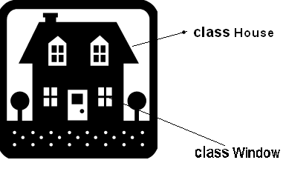
Has-a Relationships
A House “has a” or “contains a” Window

Slide 39
Has-a Relationships
refers to a relationship where one class contains objects of another class as it’s data members
Also called as “Containership”
but the objects are directly contained in the containing class (not just references to them)
This has two forms:
  Aggregation
    House has chair
  Composition
    Car has engine
Notes:
Has-a relationship is close to the real world problems. A car has door, a car has engine etc.
This relationship is just the inverse version of the part-of relationship.
“Has a “ relationship has two forms namely composition and aggregation.
In a real world most of the Objects are composition of sub objects. For example car composes engine, door etc.
Aggregation is a weak form of “has a” relationship. Example for aggregation is House has Chair, Table etc. In this case even if the house is destroyed its furniture can be used.
Composition is a strong form of “has a” relationship. In composition if the composed object is destroyed then its sub objects will also be destroyed.
.

Slide 40
Has-a relationship through containment
#include <iostream>
using namespace std;
class Engine
{
private:
char charEngineChassiNo[20];
int intEngineModel;
public:
Engine() { }
void start()
{
cout<<“engine starts”<<endl;
}};
class Car{
private:
Engine objCarEng;
char charCarColor[15];
char charCarMake[20];
public:
Car() { }
void start()
{
objCarEng.start();
cout<<“Car starts”<<endl;
}
};
Notes:
Note: complete the above code snippet with the main() in order to execute

Slide 41
Has-a Relationship through private inheritance-Rarely Used
#include <iostream>
using namespace std;
class Engine
{
private:
char charEngineChassiNo[20];
int charEngineModel;
public:
Engine() { }
void start()
{
cout<<“engine starts”<<endl;
}};
class Car :private Engine {
private:
char charCarColor[15];
char charCarMake[20];
public:
Car():Engine() { }
void start()
{
Engine::start();
cout<<“Car starts”<<endl;
}
};
Notes:
Implementation of Has-a-Relationship using Private inheritance is not encouraged.
Note: complete the above code snippet with the main() in order to execute

Slide 42
Uses Relationship
It is a form of a ‘association’
Object of class ABC can use object of class XYZ
If objABC can send some message to object objXYZ, then object objABC uses object objXYZ.
  Here objABC and objXYZ are objects of classes ABC and XYZ.

Slide 43
Different Ways to implement uses relationship in C++
Containment
  The receiver is a field in the sender.
Argument of a method
  The receiver is an argument in one of the senders methods.
Ask someone else
  The sender asks someone else to give them the receiver
Creation
  The receiver is created by the sender

Slide 44
Implementation of uses relationship through containment
#include<iostream>
using namespace std;
class CallMe
{
public:
void display()
{
cout<<"Call me is called"<<endl;
}
};
class Caller
{
/* containment */
CallMe objCme;
public:
void display() {
cout<<"This is caller , will now call Call Me"<<endl;
/* uses relatioship Caller object passes message to CallMe object */
objCme.display();
}
};
int main()
{
Caller objClr;
objClr.display();
}
Notes:
In this example object of CallMe class is used by Caller object. Object of Caller sends message to object of CallMe class.
i.e display method of CallMe is invoked within the display method of Caller class.
Note that in this example Caller object contains CallMe object.

Slide 45
Implementation of uses relationship through argument of a method
#include<iostream>
using namespace std;
class CallMe
{
public:
void display()
{
cout<<"Call me is called"<<endl;
}
};
class Caller
{
public:
/* this method accepts CallMe object as argument */
void display( CallMe objCme) {
cout<<"This is caller , will now call Call Me"<<endl;
/* uses relatioship Caller object passes message to CallMe object */
objCme.display();
}};
int main()
{
Caller objClr;
CallMe objCallMe;
objClr.display(objCallMe);
}
Notes:
In this example object of CallMe class is used by Caller object. Object of Caller sends message to object of CallMe class.
i.e display method of CallMe is invoked within the display method of Caller class.
Note that in this example display method of Caller class takes CallMe object as an argument.

Slide 46

Thoughts!
Is it safe to delete the same pointer twice?
Can we free() pointers allocated with new? Can we delete pointers allocated with malloc()?
How do we allocate / de-allocate an array of things?
What if we try and delete a pointer that has been assigned
the address of a static variable?
What if we forget the [ ] when deleting array allocated via new Data[n]?
If you have implemented copy constructor then what are the other two functions you must implement?
When does the life of a statically allocated variable end?
When does the life of a dynamically allocated variable end?
Are constructors and destructors called when we
dynamically allocate memory for an object of a class
using malloc() / free()?

Slide 47
References
C++ FAQs 2nd ed., 2nd edn, Addison Wesley.

